Slide 1
WorkingWithR
資料科學 Data Science
張家銘 Jia-Ming Chang
政治大學資訊科學系
The slide is only for educational purposes. If any infringement, please contact me. We will correct immediately.

Slide 2
Copyright declaration 版權說明
Some of the figures in this presentation are taken from "An Introduction to Statistical Learning, with applications in R" (Springer, 2013) with permission from the authors: G. James, D. Witten, T. Hastie and R. Tibshirani.
The web site of the book
The credit of individual is indicated in the bottom part of the slide.
ie.,

Slide 3
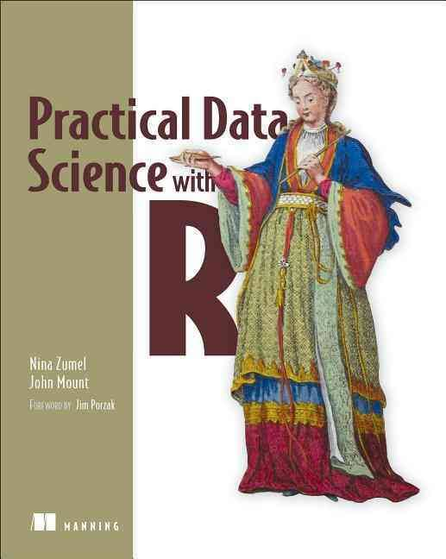
Copyright declaration 版權說明
Some of the figures in this presentation are taken from "Practical Data Science with R (Manning, 2019)”
The web site of the book
The credit of individual is indicated in the bottom part of the slide.
ie.,

Slide 4
Copyright declaration 版權說明
Some of the figures in this presentation are taken from "R for Data Science” under the Creative Commons Attribution-NonCommercial-NoDerivs 3.0 License.
The web site of the book
The credit of individual is indicated in the bottom part.
ie.,

Slide 5
Data Science this week
How much Math & Stats do I need on my Data Science resume?
https://www.datascienceweekly.org/articles/how-much-math-stats-do-i-need-on-my-data-science-resume
That said, there are a few mainstays that, irrespective of role, you should be demonstrating on your resume. Either through your academic courses/coursework, online courses you've taken, or project work you've completed. Specifically:

Slide 6
Data Science this week
Specifically
Linear algebra (and ideally basic multivariate calculus)
Regression ... linear regression and the things that violate the assumptions of linear models (e.g., autocorrelation in time series data, non-independent observations)
Probability theory ... especially Bayes' Law and Central Limit Theorem
Numerical analysis (e.g., time series analysis and forecasting)
Core machine learning methods (clustering, decision trees, k-NN)

Slide 7
Recap from the last week

Slide 8
Data Science
The data scientist is responsible for
Data : acquiring the data, managing the data
Modeling: choosing the modeling technique, writing the code
Evaluation: verifying the results

Slide 9
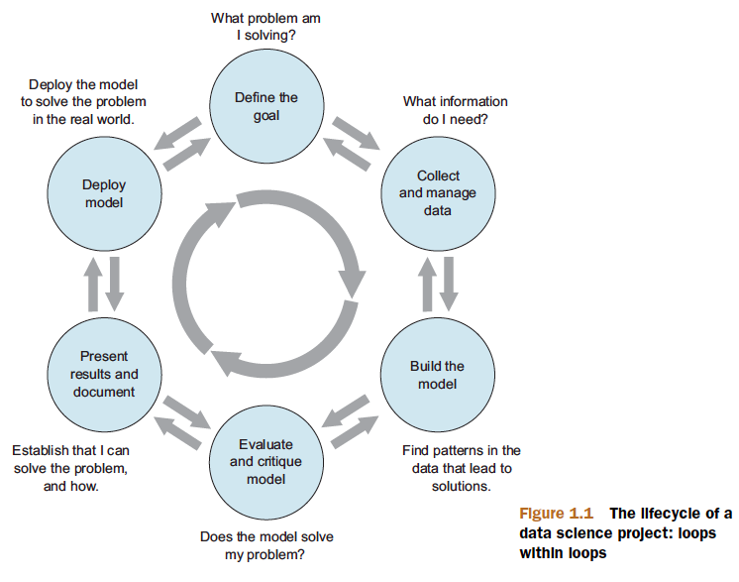
Data Science project
Find your own data set
Before midterm
Figure 1.1, Practical Data Science with R by Nina Zumel,John Mount

Slide 10
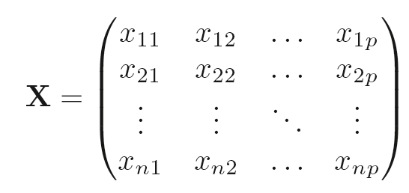
X denotes a n x p matrix
Practical Data Science with R by Nina Zumel, John Mount

Slide 11
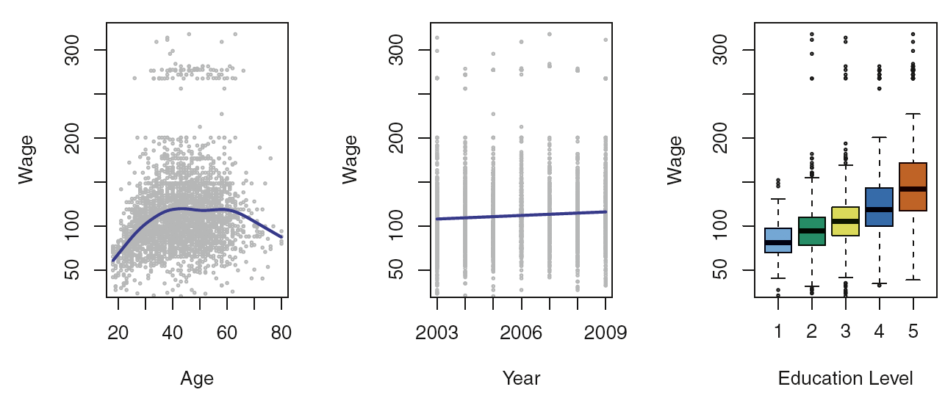
Supvervised
Figure 1.1, An Introduction to Statistical Learning with Applications in R by Gareth James, Daniela Witten, Trevor Hastie, Robert Tibshirani

Slide 12
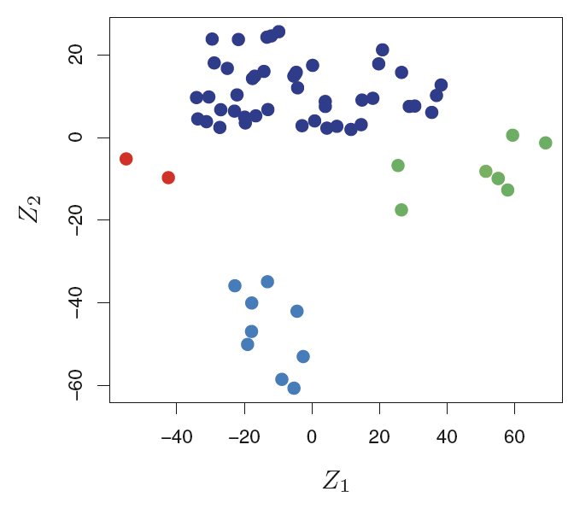
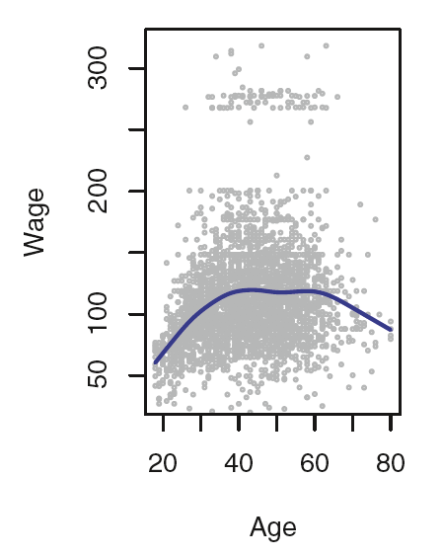
Regression v.s. Classification
Figure 1.1 & 1.4, An Introduction to Statistical Learning with Applications in R by Gareth James, Daniela Witten, Trevor Hastie, Robert Tibshirani

Slide 13
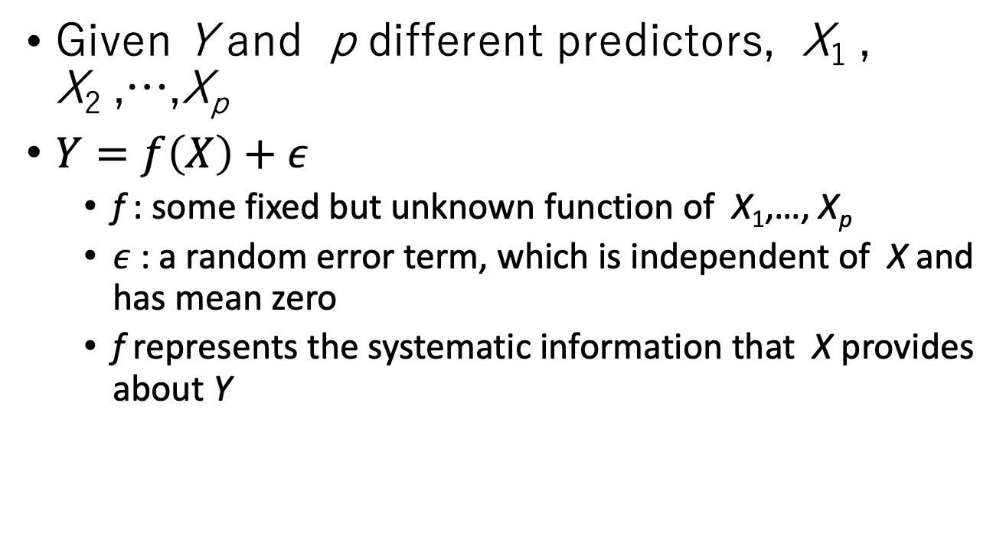
Modeling
Given Y and p different predictors, X₁ , X₂ ,…,X_{p}
$Y=f\left(X\right)+ε$
f : some fixed but unknown function of X₁,…, X_{p}
$ε$ : a random error term, which is independent of X and has mean zero
f represents the systematic information that X provides about Y
An Introduction to Statistical Learning with Applications in R by Gareth James, Daniela Witten, Trevor Hastie, Robert Tibshirani

Slide 14
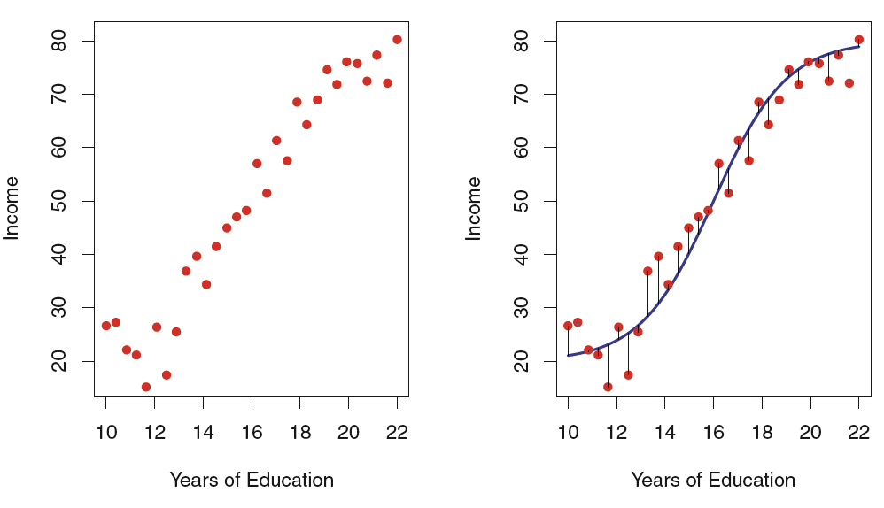
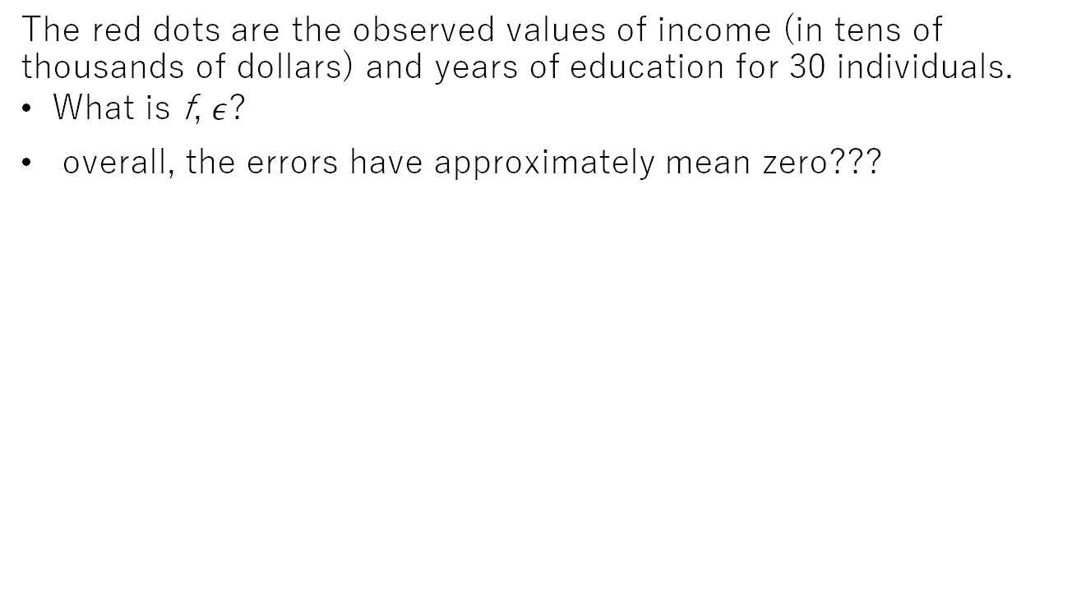
The income data set
The red dots are the observed values of income (in tens of thousands of dollars) and years of education for 30 individuals.
What is f, $ε$?
overall, the errors have approximately mean zero???
Figure2.2, An Introduction to Statistical Learning with Applications in R by Gareth James, Daniela Witten, Trevor Hastie, Robert Tibshirani

Slide 15
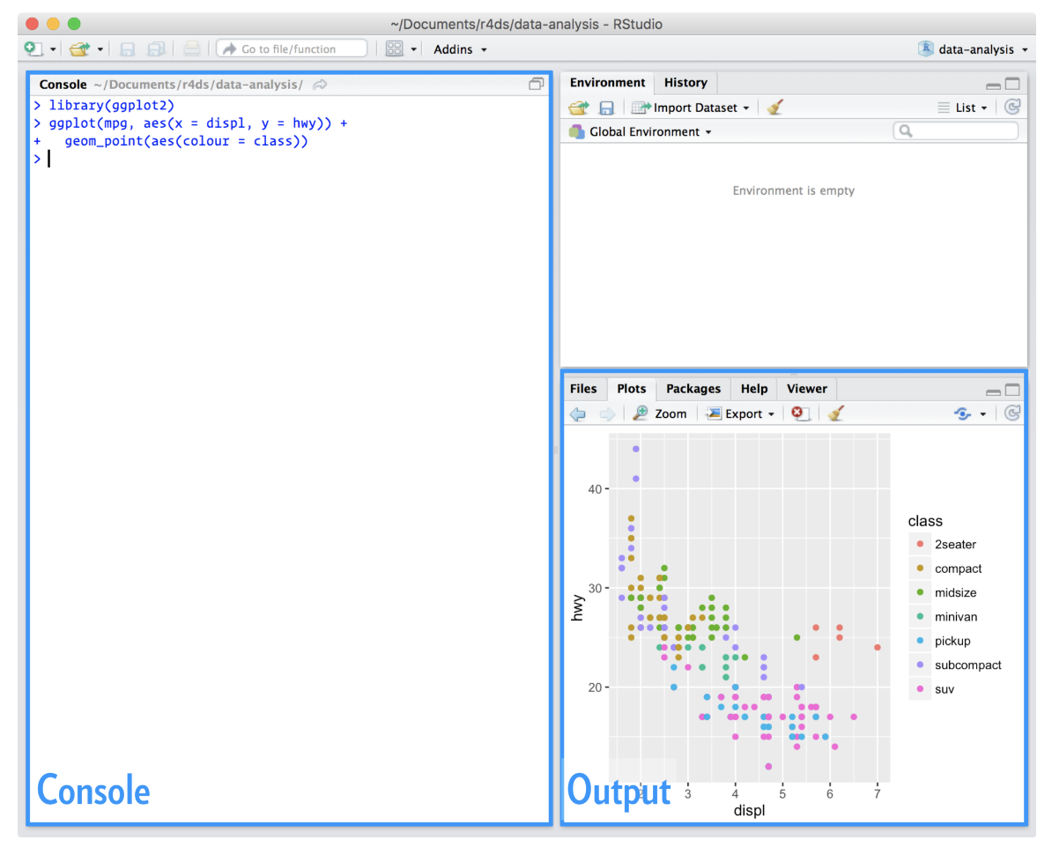
Installing RStudio
An integrated development environment, or IDE, for R programming.
https://www.rstudio.com/products/rstudio/download/
Figure 1.4.2, R for Data Science by Garrett Grolemund, Hadley Wickham

Slide 16
Basic Commands
?funcname
set.seed(1303)
rnorm(50)
sessionInfo()
what packages are present in your session
An Introduction to Statistical Learning with Applications in R by Gareth James, Daniela Witten, Trevor Hastie, Robert Tibshirani

Slide 17
Example Code
Readthedoc
code02.zip
Run R script from command line
Rscript code02/<example>.R

Slide 18
Today
Practical Data Science with R, Nina Zumel and John Mount, (Manning, 2019)
appendix A: Working with R and other tools
R for Data Science, Hadley Wickham & Garrett Grolemund
Cha 4. Workflow: basics
Cha 6. Workflow: scripts
Cha 8. Workflow: projects
Cha27. R Markdown

Slide 19
Outline
Working with R
Primary R data types
Distributions
Loading Data into R
R Workflow: project
Version control by Git
Documentation & R Markdown

Slide 20
Working with R

Slide 21
R as a calculator
calculator.R
1 / 200 * 30
(59 + 73 + 2) / 3
sin(pi / 2)
R for Data Science by Garrett Grolemund, Hadley Wickham

Slide 22
Assignment
# create new objects with <-
x <- 3 * 4
<- (Recommend)
=
RStudio’s keyboard shortcut
Alt + - (the minus sign)
automagically surrounds <- with spaces
R for Data Science by Garrett Grolemund, Hadley Wickham

Slide 23
? Why <-, not =
assExam1.R
Binding values to function arguments
divide <- function(numerator, denominator) { numerator/denominator }
divide(2,1)
divide(denominator=2,numerator=1)
divide(denominator<-2,numerator<-1)
Which commend will give a wrong answer?

Slide 24
What’s in a name?
Object names must start with a letter, and can only contain
Letters
Numbers
_
.

Slide 25
Naming rule
snake_case where you separate lowercase words with _
i_use_snake_case min_hei
otherPeopleUseCamelCase
some.people.use.periods
And_aFew.People_RENOUNCEconvention

Slide 26
Fix assignment
this_is_a_really_long_name <- 2.5
Type “this” then press Cmd/Ctrl + ↑.
R for Data Science by Garrett Grolemund, Hadley Wickham

Slide 27
x <- 5 vs. x <<- 5
sideEff.R
x <- 1
good <- function() { x <- 5}
good()
print(x)
bad <- function() { x <<- 5}
bad()
print(x)
An Introduction to Statistical Learning with Applications in R by Gareth James, Daniela Witten, Trevor Hastie, Robert Tibshirani
Notes:
Output?

Slide 28
Calling functions
seq(1, 10)
Type se
hit TAB.
Specify seq() by typing more (a “q”) to disambiguate, or by using ↑/↓ arrows to select.
If you want more help, press F1 to get all the details in help tab in the lower right pane.
Press TAB once more when you’ve selected the function you want.
R for Data Science by Garrett Grolemund, Hadley Wickham

Slide 29
“print to screen”
y <- seq(1, 10, length.out = 5)
(y <- seq(1, 10, length.out = 5))
R for Data Science by Garrett Grolemund, Hadley Wickham

Slide 30
Why does this code not work?
my_variable <- 10
my_varıable
R for Data Science by Garrett Grolemund, Hadley Wickham

Slide 31
What is wrong?
library(tidyverse)
ggplot(dota = mpg) + geom_point(mapping = aes(x = displ, y = hwy))
fliter(mpg, cyl = 8)
filter(diamond, carat > 3)
R for Data Science by Garrett Grolemund, Hadley Wickham

Slide 32
What is wrong?
library(tidyverse)
ggplot(data = mpg) + geom_point(mapping = aes(x = displ, y = hwy))
filter(mpg, cyl == 8)
filter(diamonds, carat > 3)
R for Data Science by Garrett Grolemund, Hadley Wickham

Slide 33
Keyboard Shortcuts
Press Alt + Shift + K. What happens?
R for Data Science by Garrett Grolemund, Hadley Wickham

Slide 34
Vectorized Operations
vecOpe.R
Many R operations are called vectorized
R truth tables for boolean operators
c(T,T,F,F) == c(T,F,T,F)
c(T,T,F,F) & c(T,F,T,F)
c(T,T,F,F) | c(T,F,T,F)
An Introduction to Statistical Learning with Applications in R by Gareth James, Daniela Witten, Trevor Hastie, Robert Tibshirani

Slide 35
&, | vs. &&, ||
c(T,T,F,F) & c(T,F,T,F)
c(T,T,F,F) && c(T,F,T,F)
An Introduction to Statistical Learning with Applications in R by Gareth James, Daniela Witten, Trevor Hastie, Robert Tibshirani
Notes:
Output?

Slide 36
Shorter vs longer forms
Shorter form
performs elementwise comparisons in much the same way as arithmetic operators
Longer form
Evaluation proceeds only until the result is determined.
appropriate for programming control-flow and typically preferred in if clauses.
If ((x) && (y) && (c))
x <- 5
if (x > 0 && x < 10) {
print("x is positive and less than 10")
} else {
print("x is either negative or greater than 10")
}

Slide 37
Test if two vectors are a match?
vecIde.R
c(T,T,F,F) == c(T,F,T,F)
identical(c(T,T,F,F),c(T,F,T,F))
all.equal(c(T,T,F,F),c(T,F,T,F))
An Introduction to Statistical Learning with Applications in R by Gareth James, Daniela Witten, Trevor Hastie, Robert Tibshirani
Notes:
How to test whether they are identical?

Slide 38
Primary features of R
priFea.R
R is an object-oriented language
class(c(1,2))
R is a functional language
add <- function(a,b) { a + b}
add(1,2)
R is a dynamic language
You can find all of your variables using the ls() command
An Introduction to Statistical Learning with Applications in R by Gareth James, Daniela Witten, Trevor Hastie, Robert Tibshirani

Slide 39
R behaves like a call-by-value language
callByValue.R
vec <- c(1,2)
fun <- function(v) { v[[2]]<-5; print(v)}
fun(vec)
print(vec)
v <- c(1,2)
fun <- function(v) { v[[2]]<<-5; print(v)}
fun(v)
print(v)
v <- c(1,2)
fun <- function(v) { v[[2]]<-5; print(v)}
fun(v)
print(v)
Practical Data Science with R by Nina Zumel, John Mount
Notes:
What is output?

Slide 40
Primary R data types

Slide 41
Primary R data types
Numbers
Number sequences
Vectors
Lists
Matrices
Data frames
Factors
Null and NA
Which one is central data structure?
Practical Data Science with R by Nina Zumel, John Mount

Slide 42
Numbers
Numbers in R are primarily represented in double-precision floating-point.
floatingpoint.R
1/5
3/5-2/5
1/5==3/5-2/5
Practical Data Science with R by Nina Zumel, John Mount
Notes:
True or False?

Slide 43
Numbers
Numbers in R are primarily represented in double-precision floating-point.
floatingpoint.R
sprintf("%.20f",1/5)
sprintf("%.20f",3/5-2/5)
all.equal(1/5,3/5-2/5)
Practical Data Science with R by Nina Zumel, John Mount
Notes:
Which function for testing 1/5 equal to 3/5-2/5?

Slide 44
Number Sequences
numseq.R
1:10
1:2*5
1:(2*5)
rep(1,10)
rep(10,1)
Practical Data Science with R by Nina Zumel, John Mount

Slide 45
Vectors
vec.R
a <- c(1:10)
length(a)
a[1]
a[[1]]
Practical Data Science with R by Nina Zumel, John Mount

Slide 46
[[]] vs []
a[11]
a[[11]]
When extracting single values, we prefer the double squarebrace notation [[]] as it gives out-of-bounds warnings in situations where [] doesn’t.
Practical Data Science with R by Nina Zumel, John Mount

Slide 47
NULL v.s. NA
null.R
b<-c()
length(b)
is.null(b)
is.na(b)
NULL can only occur where a vector or list is expected
NA for missing values (like a single number or string)
NA is a logical constant of length 1 which contains a missing value indicator.
Practical Data Science with R by Nina Zumel, John Mount
Notes:
Which one will return TRUE?

Slide 48
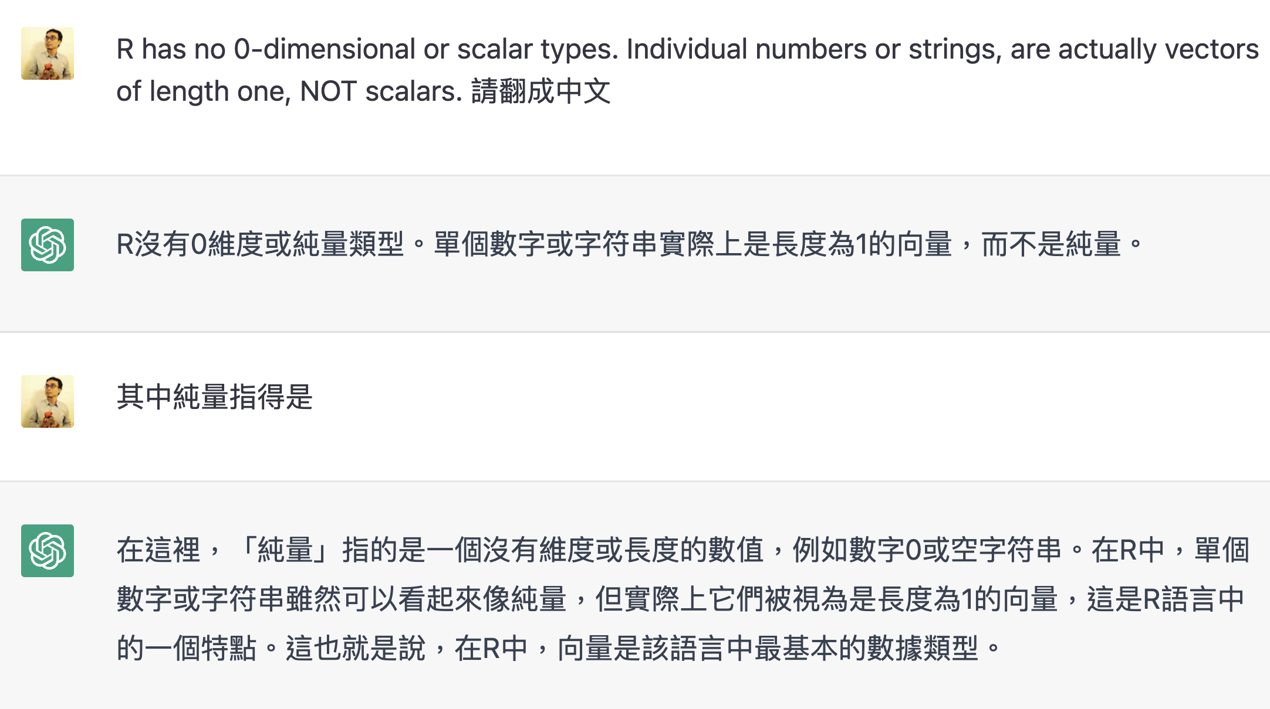
Vectors
R has no 0-dimensional or scalar types. Individual numbers or strings, are actually vectors of length one, NOT scalars.

Slide 49
Vector vs List
vecVSlist.R
c(6,'fred')
list(6,'fred')
Lists, unlike vectors, can store more than one type of object
Practical Data Science with R by Nina Zumel, John Mount

Slide 50
Named lists
namelist.R
x <- list('a'=6,b='fred')
names(x)
x$a
x$b
x[['a']]
Practical Data Science with R by Nina Zumel, John Mount

Slide 51
[[]] vs []
brackets.R
signal outof-bounds access
c('a','b’)[[2]]
c('a','b’)[2]
c('a','b')[[7]]
c('a','b')[7]
[[]] unwraps the returned value
list(a='b')['a']
list(a='b')[['a']]
Practical Data Science with R by Nina Zumel, John Mount

Slide 52
[[]] vs []
[] accept vectors as its argument
list(a=1, b=2, c=3)[c('a', 'c')]
list(a=1, b=2, c=3)[[c('a', 'c')]]
Really you should never use [] when [[]] can be used (when you want only a single result)
Practical Data Science with R by Nina Zumel, John Mount

Slide 53
Basic Commands
?matrix
x=matrix(data=c(1,2,3,4) , nrow=2, ncol =2)
x=matrix(c(1,2,3,4) ,2,2)
matrix(c(1,2,3,4) ,2,2,byrow =TRUE)
sqrt(x)
x^2
Practical Data Science with R by Nina Zumel, John Mount

Slide 54
Matrices
matrix.R
b<-matrix(c(2,4,3,1,5,7), nrow=3,ncol=2)
b[1,2]
b[2,1]
Practical Data Science with R by Nina Zumel, John Mount

Slide 55
Matrices
matrix.R
Transpose
t(b)
cbind(b, b)
rbind(b, b)
Matrices : lists of rows, and every cell in a matrix has the same type.
Practical Data Science with R by Nina Zumel, John Mount

Slide 56
Data Frames
dataframe.R
d = data.frame(x=c(1,2,3), y=c('x','y','z'))
Select columns
d[,1] = d[,'x'] = d[['x']] = d$x
Select rows
d[c(1,3),] = subset(d,c(T,F,T))
Practical Data Science with R by Nina Zumel, John Mount

Slide 57
Data frames
The data scientist doesn’t expect to be so lucky as to find such a dataset ready for them to work with. In fact, 90% of the data scientist’s job is figuring out how to transform data into this form.
data tubing: joining data from multiple sources, finding new data sources, and working with business and technical partners
Practical Data Science with R by Nina Zumel, John Mount

Slide 58
Matrices vs data frame
Matrices
lists of rows
every cell in a matrix has the same type
Data Frame
list of columns
different types
design
the column types
the names are the schema
the rows are the data
Practical Data Science with R by Nina Zumel, John Mount

Slide 59
Factors
factor.R
str(d)
“set of strings” for levels of categorical variables
factor('red',levels=c('red','orange'))
factor('apple',levels=c('red','orange'))
Practical Data Science with R by Nina Zumel, John Mount

Slide 60
Coding style
The Google R Style Guide
Hadley Wickham's style guide from Advanced R
R tips and tricks by Nina Zumel & John Mount
Practical Data Science with R by Nina Zumel, John Mount

Slide 61
Distributions

Slide 62
Distributions
the normal distribution
the lognormal distribution
the binomial distribution
Practical Data Science with R by Nina Zumel, John Mount
Notes:
Can someone tell me the difference between them?

Slide 63
Normal (Gaussian) distribution
classic symmetric bell-shaped curve
Credit by https://www.mathsisfun.com/data/standard-normal-distribution.html

Slide 64
Normal distribution
Repeated measurements will tend to fall into a normal distribution.
Central limit theorem says that when you’re observing the sum (or mean) of many independent, bounded variance random variables, the distribution of your observations will approach the normal as you collect more data.
Practical Data Science with R by Nina Zumel, John Mount
Notes:
Central limit theorem ?

Slide 65
Plotting the normal density
normalDist.R
The theoretical
library(ggplot2)
x <- seq(from=-5, to=5, length.out=100) #the interval[-5 5]
f <- dnorm(x) # normal with mean 0 and sd 1
ggplot(data.frame(x=x,y=f), aes(x=x,y=y)) + geom_line()
Practical Data Science with R by Nina Zumel, John Mount

Slide 66
Plotting the normal density
normalDist.R
An empirical
u <- rnorm(1000)
ggplot(data.frame(x=u), aes(x=x)) + geom_density() + geom_line(data=data.frame(x=x,y=f), aes(x=x,y=y), linetype=2)
Practical Data Science with R by Nina Zumel, John Mount

Slide 67
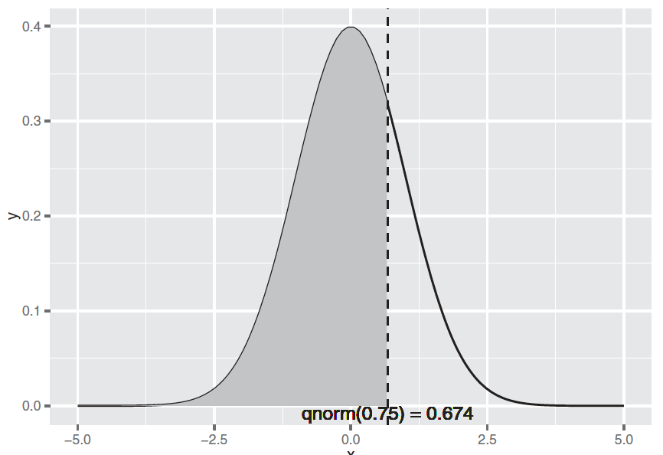
Illustrating x < qnorm(0.75)
cumDist.R
qnorm(0.75)
pnorm(0.6744898)
Figure B.3, Practical Data Science with R by Nina Zumel, John Mount

Slide 68
Illustrating x < qnorm(0.75)
x <- seq(from=-5, to=5, length.out=100)
f <- dnorm(x)
nframe <- data.frame(x=x,y=f)
line <- qnorm(0.75)
xstr <- sprintf("qnorm(0.75) = %1.3f", line)
nframe75 <- subset(nframe, nframe$x < line)
ggplot(nframe, aes(x=x,y=y)) + geom_line() +
geom_area(data=nframe75, aes(x=x,y=y), fill="gray") +
geom_vline(aes(xintercept=line), linetype=2) +
geom_text(x=line, y=0, label=xstr, vjust=1)
Figure B.3, Practical Data Science with R by Nina Zumel, John Mount

Slide 69
Summarizing R’s distribution naming conventions
dDIST(x, ...)
the distribution function (PDF) that returns the probability of observing the value x.
rDIST(n, ...)
the random number generation function that returns n values drawn from the distribution DIST.
qDIST(p, ...)
the quantile function that returns the x corresponding to the pth percentile of DIST.
pDIST(x, ...)
the cumulative distribution function (CDF) that returns the probability of observing a value less than x.
Practical Data Science with R by Nina Zumel, John Mount​

Slide 70
Summarizing R’s distribution naming conventions
qDIST(p, ...)
the quantile function that returns the x corresponding to the pth percentile of DIST.
lower.tail=F : will cause qDIST(p, ...) to return the x that corresponds to the 1 - pth percentile of DIST.
pDIST(x, ...)
the cumulative distribution function (CDF) that returns the probability of observing a value less than x.
lower.tail=F : will return the probability of observing a value greater than x (the area under the right tail).
Practical Data Science with R by Nina Zumel, John Mount​

Slide 71
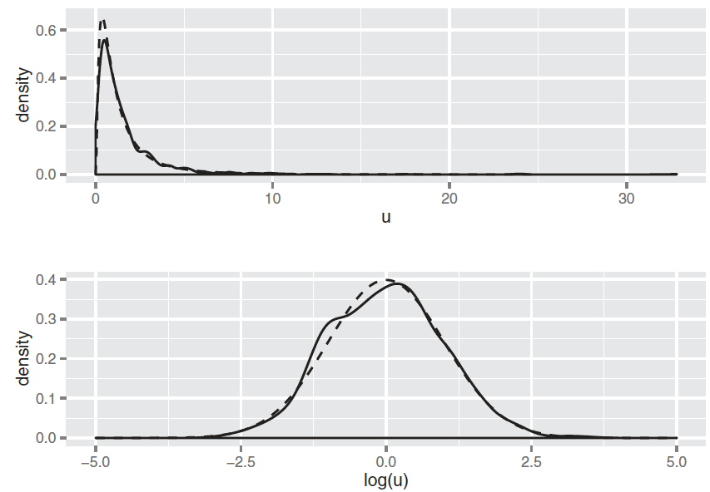
Lognormal distribution
distribution of a random variable X whose natural log, log(X), is normally distributed.
The distribution of highly skewed positive data (like incomes, sales, or stock prices) can often be modeled as a lognormal distribution.
FigureB.4, Practical Data Science with R by Nina Zumel, John Mount​

Slide 72
Binomial distribution, Bin(n,p)
the discrete probability distribution of the number of successes in a sequence of n independent experiments, each asking a yes–no question, and each with its own boolean-valued outcome: yes with probability p

Slide 73
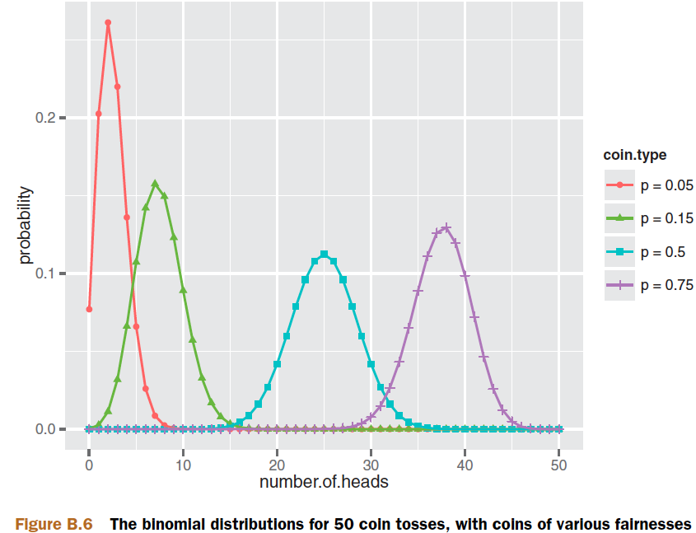
Binomial distribution
probability of observing k heads when you flip that coin N times.
a
Figure B.6, Practical Data Science with R by Nina Zumel, John Mount​

Slide 74
Plotting the binomial distribution
plotBinomial.R
library(ggplot2)
numflips <- 50
x <- 0:numflips
p <- c(0.05, 0.15, 0.5, 0.75)
plabels <- paste("p =", p)
flips <- NULL
for(i in 1:length(p)) {
coin <- p[i]
label <- plabels[i]
tmp <- data.frame(number.of.heads=x,
probability = dbinom(x, numflips, coin),
coin.type = label)
flips <- rbind(flips, tmp)
}
ggplot(flips, aes(x=number.of.heads, y=probability)) +
geom_point(aes(color=coin.type, shape=coin.type)) +
geom_line(aes(color=coin.type))
Figure B.6, Practical Data Science with R by Nina Zumel, John Mount​

Slide 75
Binomial distribution
binomial.R
probability of observing k heads when you flip that coin N times
nflips <- 100
nheads <- c(25, 45, 50, 60) # number of heads
Practical Data Science with R by Nina Zumel, John Mount​

Slide 76
Binomial distribution
binomial.R
# what are the probabilities of observing at most that number of heads on a fair coin?
P(X ≤ nheads)
left.tail <- pbinom(nheads, nflips, 0.5)
sprintf("%2.2f", left.tail)
Practical Data Science with R by Nina Zumel, John Mount​

Slide 77
Binomial distribution
binomial.R
# the probabilities of observing more than that number of heads on a fair coin?
P(X>nheads)
right.tail <- pbinom(nheads, nflips, 0.5, lower.tail=F)
sprintf("%2.2f", right.tail)
Practical Data Science with R by Nina Zumel, John Mount​

Slide 78
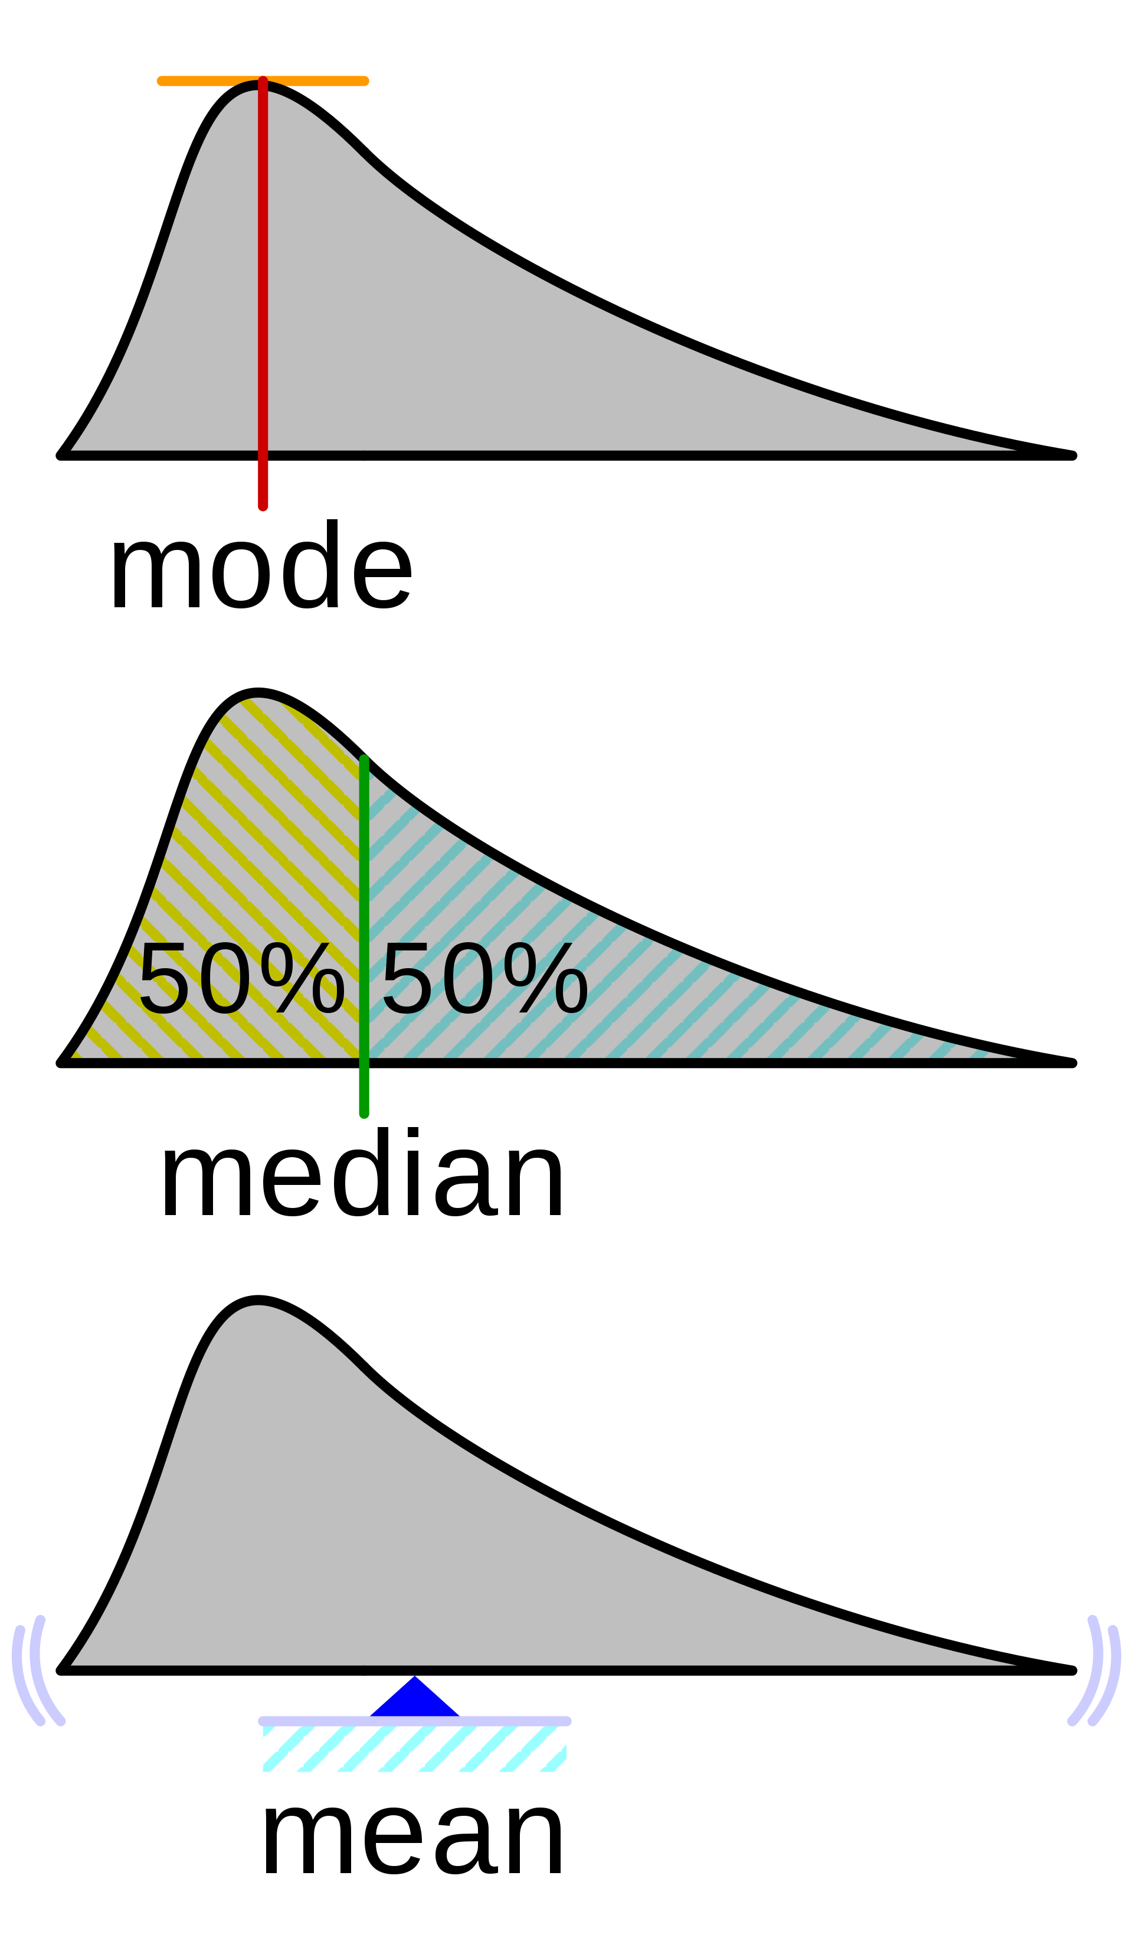
Comparison of mean, median and mode
Given numbers {1, 2, 2, 3, 4, 7, 9}
Arithmetic mean: Sum of values of a data set divided by number of values = 4
Median: Middle value separating the greater and lesser halves of a data = 3
Mode: Most frequent value in a data set = 2
By Cmglee - Own work, CC BY-SA 3.0, https://commons.wikimedia.org/w/index.php?curid=38969094

Slide 79
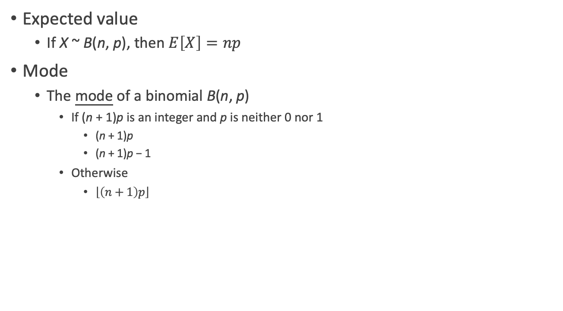
Binomial distribution
Expected value
If X ~ B(n, p), then $E\left[X\right]=np$
Mode
The mode of a binomial B(n, p)
If (n + 1)p is an integer and p is neither 0 nor 1
(n + 1)p
(n + 1)p − 1
Otherwise
$\left\lfloor \left(n+1\right)p\right\rfloor$
Notes:
Mode, why not floor(np)?

Slide 80
Loading Data into R

Slide 81
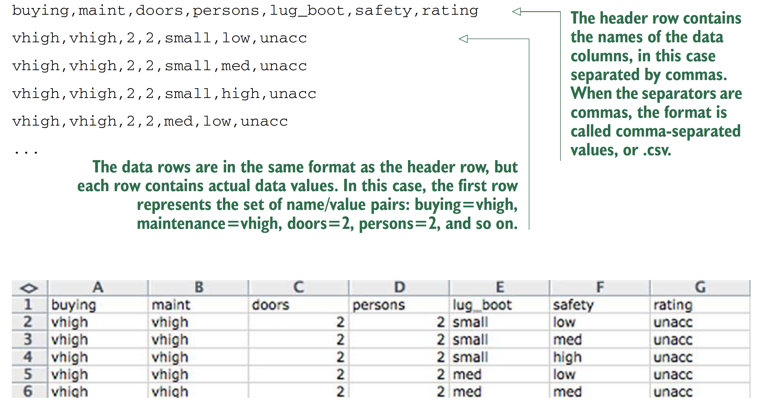
Table-structured data with headers
Practical Data Science with R by Nina Zumel, John Mount

Slide 82
If there is no header in data?
Avoid BY HAND steps
We strongly encourage you to avoid performing any steps “by hand” when importing data. It’s tempting to use an editor to add a header line to a file, as we did in our example. A better strategy is to write a script either outside R (using shell tools) or inside R to perform any necessary reformatting.
Automating these steps greatly reduces the amount of trauma and work during the inevitable data refresh.
Practical Data Science with R by Nina Zumel, John Mount

Slide 83
Reading the UCI car data
loadData.R
uciCar <- read.table( # Note: 1
'https://raw.githubusercontent.com/WinVector/Examples/main/dfiles/car.data.csv', # Note: 2
sep=',', # Note: 3
header=T # Note: 4
)
# 1: Command to read from a file or URL and store the result in a new data frame object called uciCar.
# 2: Filename or URL to get the data from.
# 3: Specify the column or field separator as a comma.
# 4: Tell R to expect a header line that defines the data column names.
Practical Data Science with R by Nina Zumel, John Mount

Slide 84
Always Exploring your data first
str(uciCar)
summary(uciCar)
dim(uciCar)
Always checking :
# of rows = # of lines of text in the original file - 1
Practical Data Science with R by Nina Zumel, John Mount
Notes:
What n, p?

Slide 85
Working with other data formats
XLS /XLSX—http://cran.r-project.org/doc/manuals/R-data.html#Reading-Excel-spreadsheets
JSON—http://cran.r-project.org/web/packages/rjson/index.html
XML—http://cran.r-project.org/web/packages/XML/index.html
MongoDB—http://cran.r-project.org/web/packages/rmongodb/index.html
SQL—http://cran.r-project.org/web/packages/DBI/index.html
Practical Data Science with R by Nina Zumel, John Mount

Slide 86
Using R on less-structured data
lessStructure.R
German bank credit dataset
d <- read.table(paste('http://archive.ics.uci.edu/ml/','machine-learning-databases/statlog/german/german.data',sep=''),stringsAsFactors=F,header=F)
head(d)
Practical Data Science with R by Nina Zumel, John Mount
Notes:
What do you find? Any problem?

Slide 87
Using R on less-structured data
schema documentation or data dictionary
colnames(d) <- c('Status.of.existing.checking.account',
'Duration.in.month', 'Credit.history', 'Purpose',
'Credit.amount', 'Savings account/bonds',
'Present.employment.since',
'Installment.rate.in.percentage.of.disposable.income',
'Personal.status.and.sex', 'Other.debtors/guarantors',
'Present.residence.since', 'Property', 'Age.in.years',
'Other.installment.plans', 'Housing',
'Number.of.existing.credits.at.this.bank', 'Job',
'Number.of.people.being.liable.to.provide.maintenance.for',
'Telephone', 'foreign.worker', 'Good.Loan')
Practical Data Science with R by Nina Zumel, John Mount

Slide 88
Building a map to interpret loan use codes
d$Good.Loan <- as.factor(ifelse(d$Good.Loan==1,'GoodLoan','BadLoan'))
mapping <- list(
'A40'='car (new)',
'A41'='car (used)',
'A42'='furniture/equipment',
'A43'='radio/television',
'A44'='domestic appliances')
http://archive.ics.uci.edu/ml/datasets/Statlog+(German+Credit+Data)
Practical Data Science with R by Nina Zumel, John Mount

Slide 89
Transforming the car data
for(i in 1:(dim(d))[2]) { # Note: 1
if(class(d[,i])=='character') {
d[,i] <- as.factor(as.character(mapping[d[,i]]))# Note: 2
}
}
summary(d$Purpose)
# 1: (dim(d))[2] is the number of columns in the data frame d.
# 2: Note that the indexing operator [] is vectorized. Each step in the for loop remaps an entire column of data through our list.
Practical Data Science with R by Nina Zumel, John Mount

Slide 90
Summary of Good.Loan and Purpose
the relation of loan type to loan outcome
table(d$Purpose,d$Good.Loan)
Practical Data Science with R by Nina Zumel, John Mount
Notes:
Which loan type with the best loan outcome?

Slide 91
Summary: Loading data into R
Data frames are your friend.
Use read.table() to load small, structured datasets into R.
Always document data provenance.
Practical Data Science with R by Nina Zumel, John Mount

Slide 92
R Workflow: project

Slide 93
Where does your analysis live?
getwd()
your current working directory
setwd("/path/to/my/CoolProject")
R for Data Science by Garrett Grolemund, Hadley Wickham

Slide 94
Paths and directories
You should never use absolute paths in your scripts, because they hinder sharing: no one else will have exactly the same directory configuration as you.
R for Data Science by Garrett Grolemund, Hadley Wickham

Slide 95
RStudio projects
projExam
Double-click, projExam.Rproj, to re-open the project
save figures to files with R code, never with the mouse or the clipboard
R for Data Science by Garrett Grolemund, Hadley Wickham

Slide 96
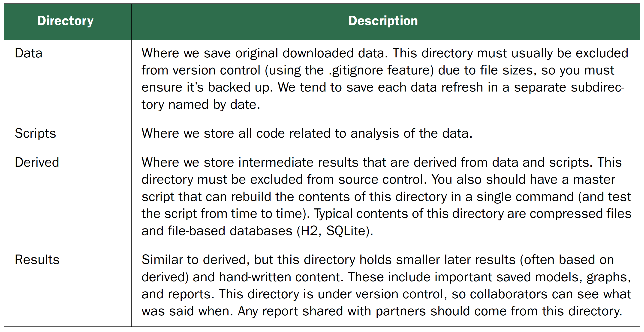
First: Choosing a Project Directory Structure
Practical Data Science with R by Nina Zumel, John Mount

Slide 97
Summary
Create an RStudio project for each data analysis project.
Keep data files there; we’ll talk about loading them into R in data import.
Keep scripts there; edit them, run them in bits or as a whole.
Save your outputs (plots and cleaned data) there.
Only ever use relative paths, not absolute paths.
R for Data Science by Garrett Grolemund, Hadley Wickham

Slide 98
Version control by Git

Slide 99
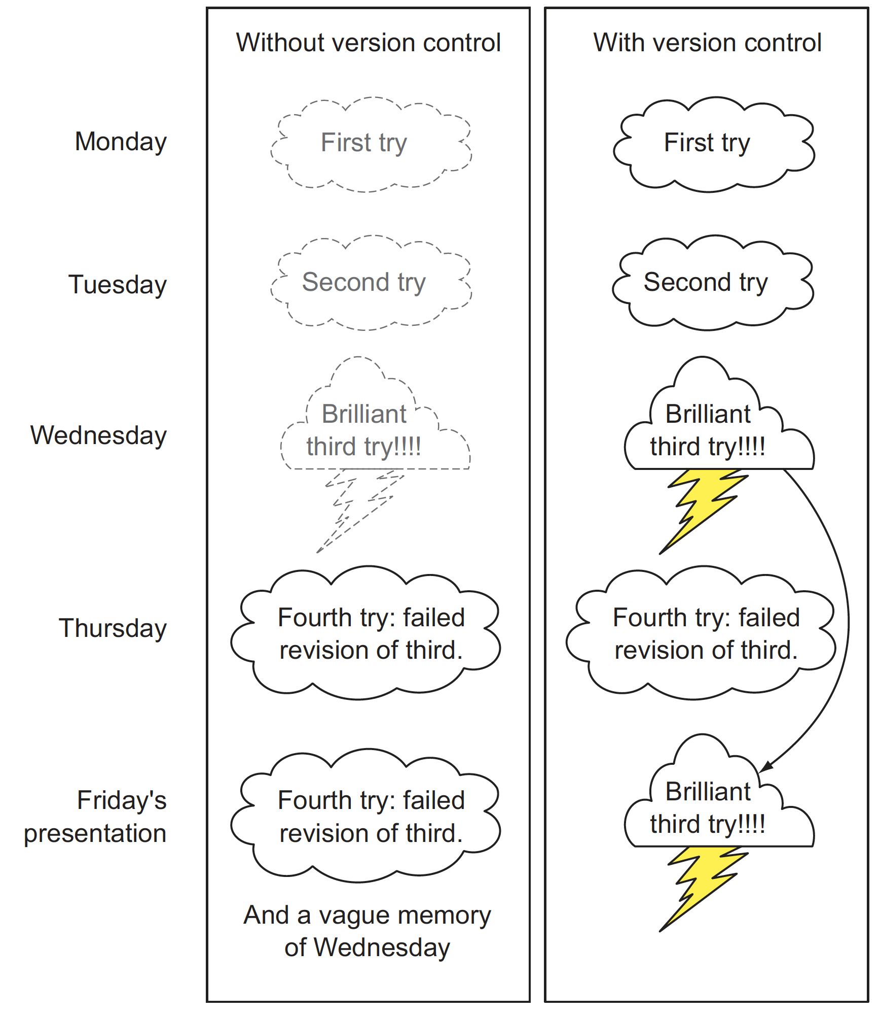
Using version control to record history
Figure10.6, Practical Data Science with R by Nina Zumel, John Mount

Slide 100
Source code management system
a distributed version control system
The development of Git began on 3 April 2005
Torvalds quipped about the name git, which is British English slang meaning "unpleasant person”.
http://git-scm.com/video/what-is-git
https://git-scm.com/downloads
https://git-scm.com/book/en/v2/Getting-Started-Installing-Git

Slide 101
Github
a web-based Git repository hosting service.
Development of the GitHub platform began on 1 October 2007.
The site was launched in April 2008 by Tom Preston-Werner, Chris Wanstrath, and PJ Hyett after it had been made available for a few months prior as a beta period.
http://www.howtogeek.com/180167/htg-explains-what-is-github-and-what-do-geeks-use-it-for/

Slide 102
Git vs. Github
Git is a revision control system, a tool to manage your source code history. think of it as a series of snapshots (commits) of your code. You see a path of these snapshots, in which order they where created. You can make branches to experiment and come back to snapshots you took.
GitHub is a hosting service for Git repositories. So, it is a web-page on which you can publish your Git repositories and collaborate with other people.
http://stackoverflow.com/questions/13321556/difference-between-git-and-github
http://stackoverflow.com/questions/11816424/understanding-the-basics-of-git-and-github

Slide 103
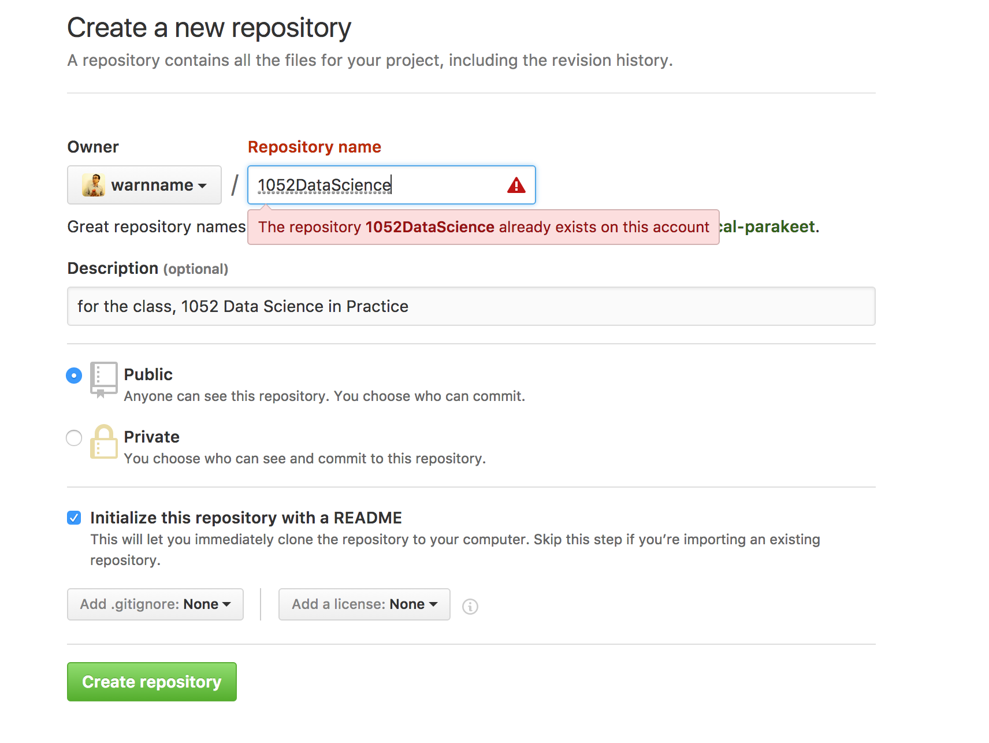

Slide 104
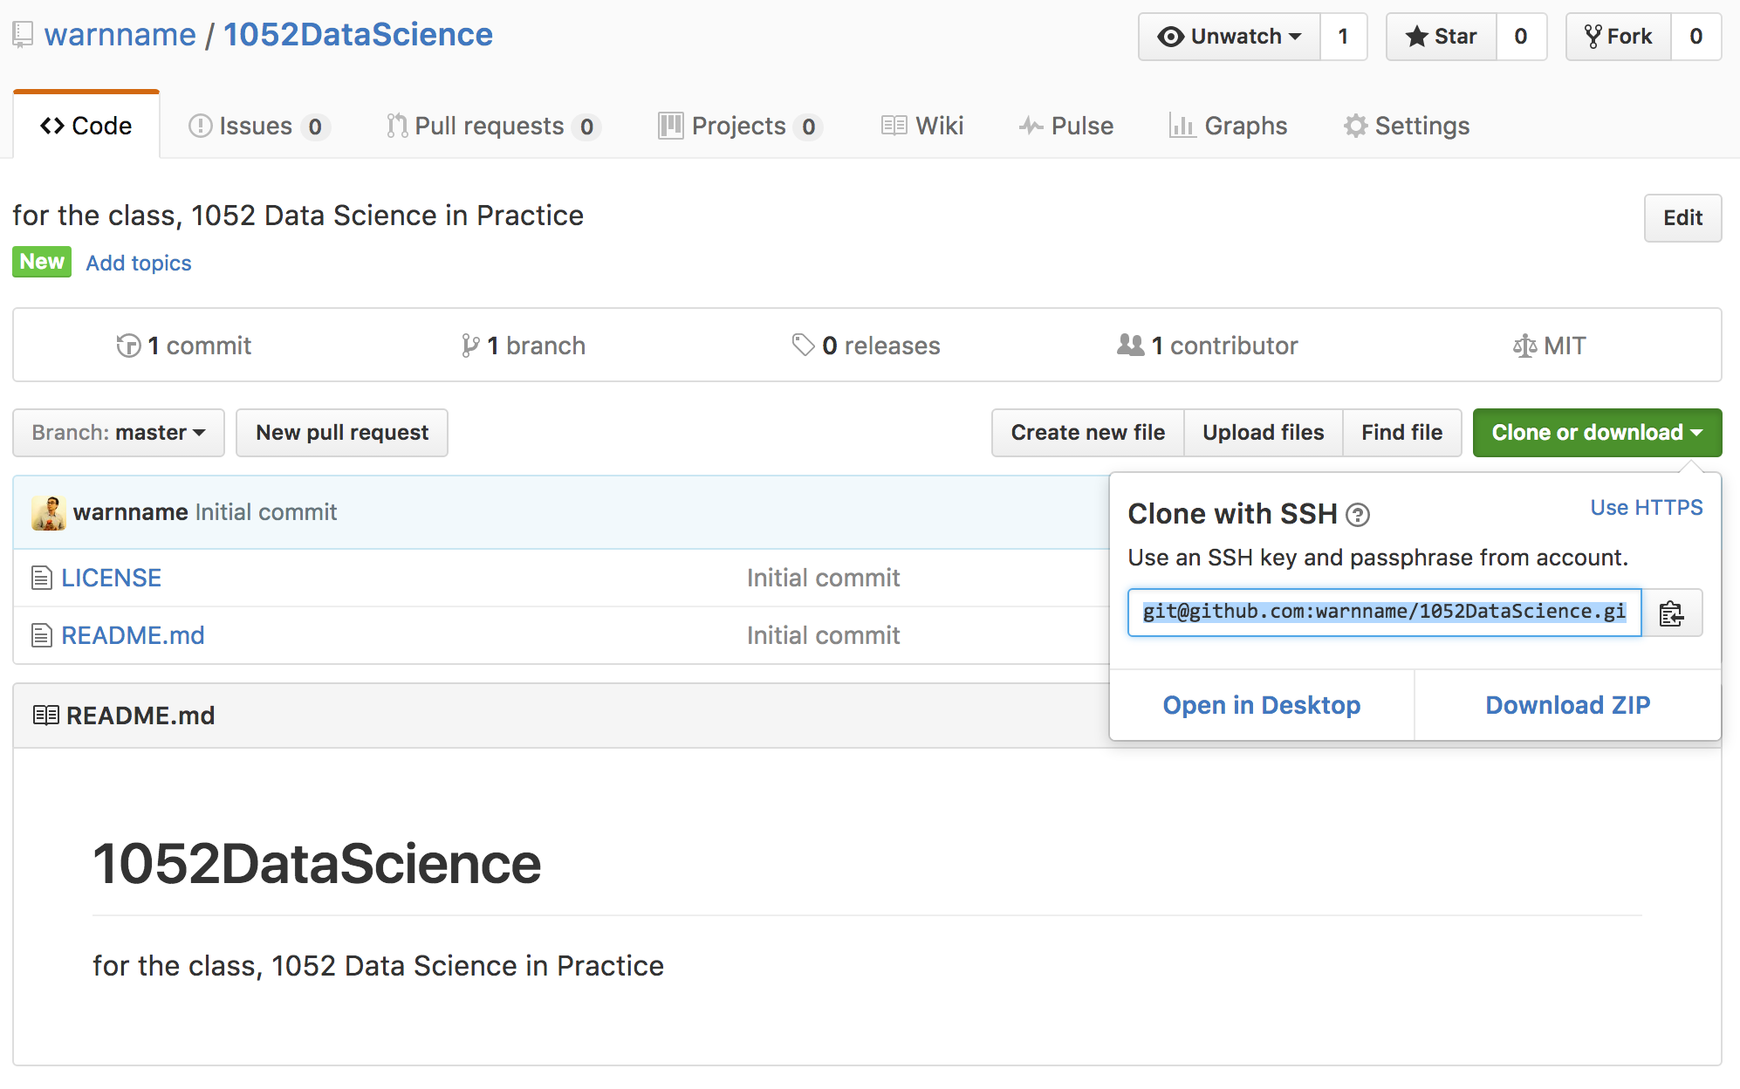

Slide 105
Adding an existing project to GitHub using the command line
creates a new remote called origin located at git@github.com:peter/first_app.git
git remote add origin git@github.com:warnname/1052dataScience.git

Slide 106
Adding an existing project to GitHub using the command line
push the commits in the local branch named master to the remote named origin
git push origin master
Permission denied (publickey).
fatal: Could not read from remote repository.
Please make sure you have the correct access rights and the repository exists.

Slide 107
Commends
git remote add origin https://github.com/warnname/1052DataScience.git
git config remote.origin.url git@github.com:warnname/1052DataScience.git
git pull origin master
git pull --allow-unrelated-histories origin master
git push origin master

Slide 108
Starting a git project using the command line
Create folder
Homework1
Data
Scripts
Derived
Results
git init .
git config --global user.name "jia-ming.chang”
git config --global user.email chang.jiaming@gmail.com
git status

Slide 109
Starting a git project using the command line
cp code03/.
touch Derived/tmp
git status
vi .gitignore
git status
Practical Data Science with R by Nina Zumel, John Mount

Slide 110
Using add/commit pairs to checkpoint work
git add -A .
git commit -m "include template file for example3”
A “wimpy commit” is better than no commit
Practical Data Science with R by Nina Zumel, John Mount

Slide 111
Finding out who wrote and when
git blame Scripts/week3_2.R
git log
git log --graph --name-status
Practical Data Science with R by Nina Zumel, John Mount

Slide 112
Git commends
Local
git init .
git add -A .
git commit
git status
git log
git diff
git checkout
Public
git pull
git rebase
git push
https://www.git-tower.com/blog/git-cheat-sheet/

Slide 113
https://github.github.com/training-kit/downloads/github-git-cheat-sheet.pdf

Slide 114
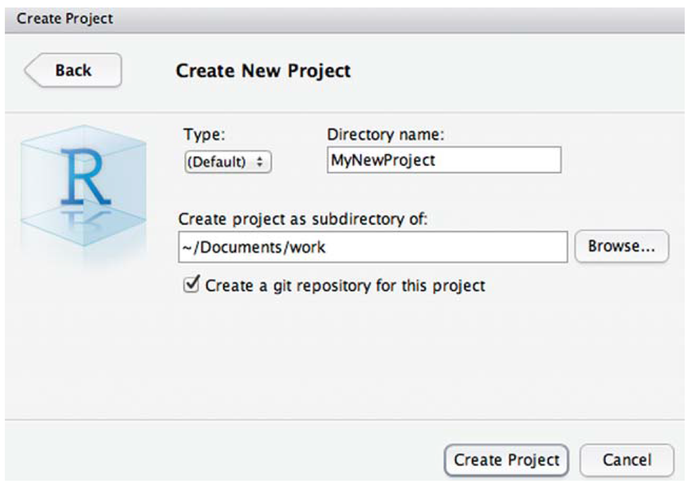
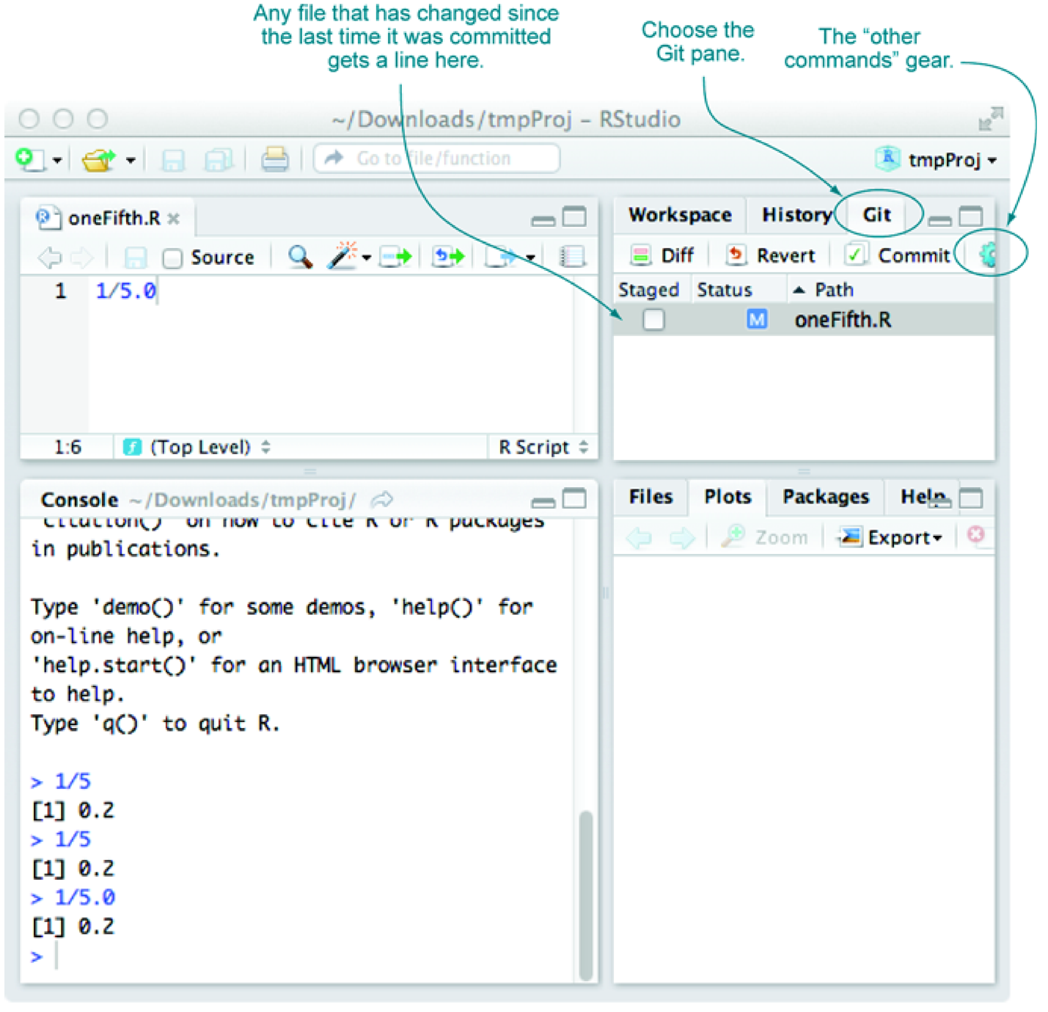
Using Git through RStudio
commit often, and if you’re committing often, all problems can be solved with some further research
Figure 10.7 & 10.8, Practical Data Science with R by Nina Zumel, John Mount

Slide 115
Connect GitHub into RStudio
https://www.r-bloggers.com/rstudio-and-github/

Slide 116
SSH
Version control repositories can typically be accessed using a variety of protocols (including http and https). Many repositories can also be accessed using SSH (this is the mode of connection for many hosting services including GitHub and R-Forge).
In many cases the authentication for an SSH connection is done using public/private RSA key pairs. This type of authentication requires two steps:
Generate a public/private key pair
Provide the public key to the hosting provider (e.g. GitHub or R-Forge)

Slide 117
Generating an SSH key
SSH keys are a way to identify trusted computers without involving passwords. You can generate an SSH key and add the public key to your GitHub account by following the procedures outlined in this section.
https://help.github.com/articles/generating-an-ssh-key/

Slide 118
Cha 10. Documentation and deployment
Cha27. R Markdown

Slide 119
Which comment is useful?
# Return the pseudo logarithm of x, which is close to
# sign(x)*log10(abs(x)) for x such that abs(x) is large and doesn't "blow up" near zero.
# Useful for transforming wide-range variables that may be negative (like profit/loss).
# See: http://www.win-vector.com/blog/2012/03/modeling-trick-the-signed-pseudo-logarithm/
# NB: This transform has the undesirable property of making most
# signed distributions appear bimodal around the origin, no matter
# what the underlying distribution really looks like.
# The argument x is assumed be numeric and can be a vector.
pseudoLog10 <- function(x) { asinh(x/2)/log(10) }
effective comments
#######################################
# Function: addone
# Author: John Mount
# Version: 1.3.11
# Location: RSource/helperFns/addone.R
# Date: 10/31/13
# Arguments: x
# Purpose: Adds one
#######################################
addone <- function(x) { x + 1 }
Useless comments
Practical Data Science with R by Nina Zumel, John Mount

Slide 120
How to write effective comments?
Good comments include
what the function does
what types arguments are expected to be : It’s critical to know if a function works correctly on lists, data frame rows, vectors, and so on.
limits of domain
why you should care about the function
where it’s from.
Practical Data Science with R by Nina Zumel, John Mount

Slide 121
How to write effective comments?
Of critical importance are any NB (note well) or TODO notes.
It’s vastly more important to document any unexpected features or limitations in your code than to try to explain the obvious.
Practical Data Science with R by Nina Zumel, John Mount

Slide 122
Worse than useless comment
# adds one
addtwo <- function(x) { x + 2 }
Practical Data Science with R by Nina Zumel, John Mount

Slide 123

Markdown (.md, .markdown)
a lightweight markup language for creating formatted text using a plain-text editor.
John Gruber and Aaron Swartz created Markdown in 2004 as a markup language that is intended to be easy to read in its source code form.
https://en.wikipedia.org/wiki/Markdown
a text-to-HTML conversion tool for web writers. Markdown allows you to write using an easy-to-read, easy-to-write plain text format, then convert it to structurally valid XHTML (or HTML).
http://daringfireball.net/projects/markdown/
a simple web-ready format that’s used in many wikis
https://zh.wikipedia.org/wiki/T-Coffee
Notes:
搭配說明 R Markdown reference guide

Slide 124
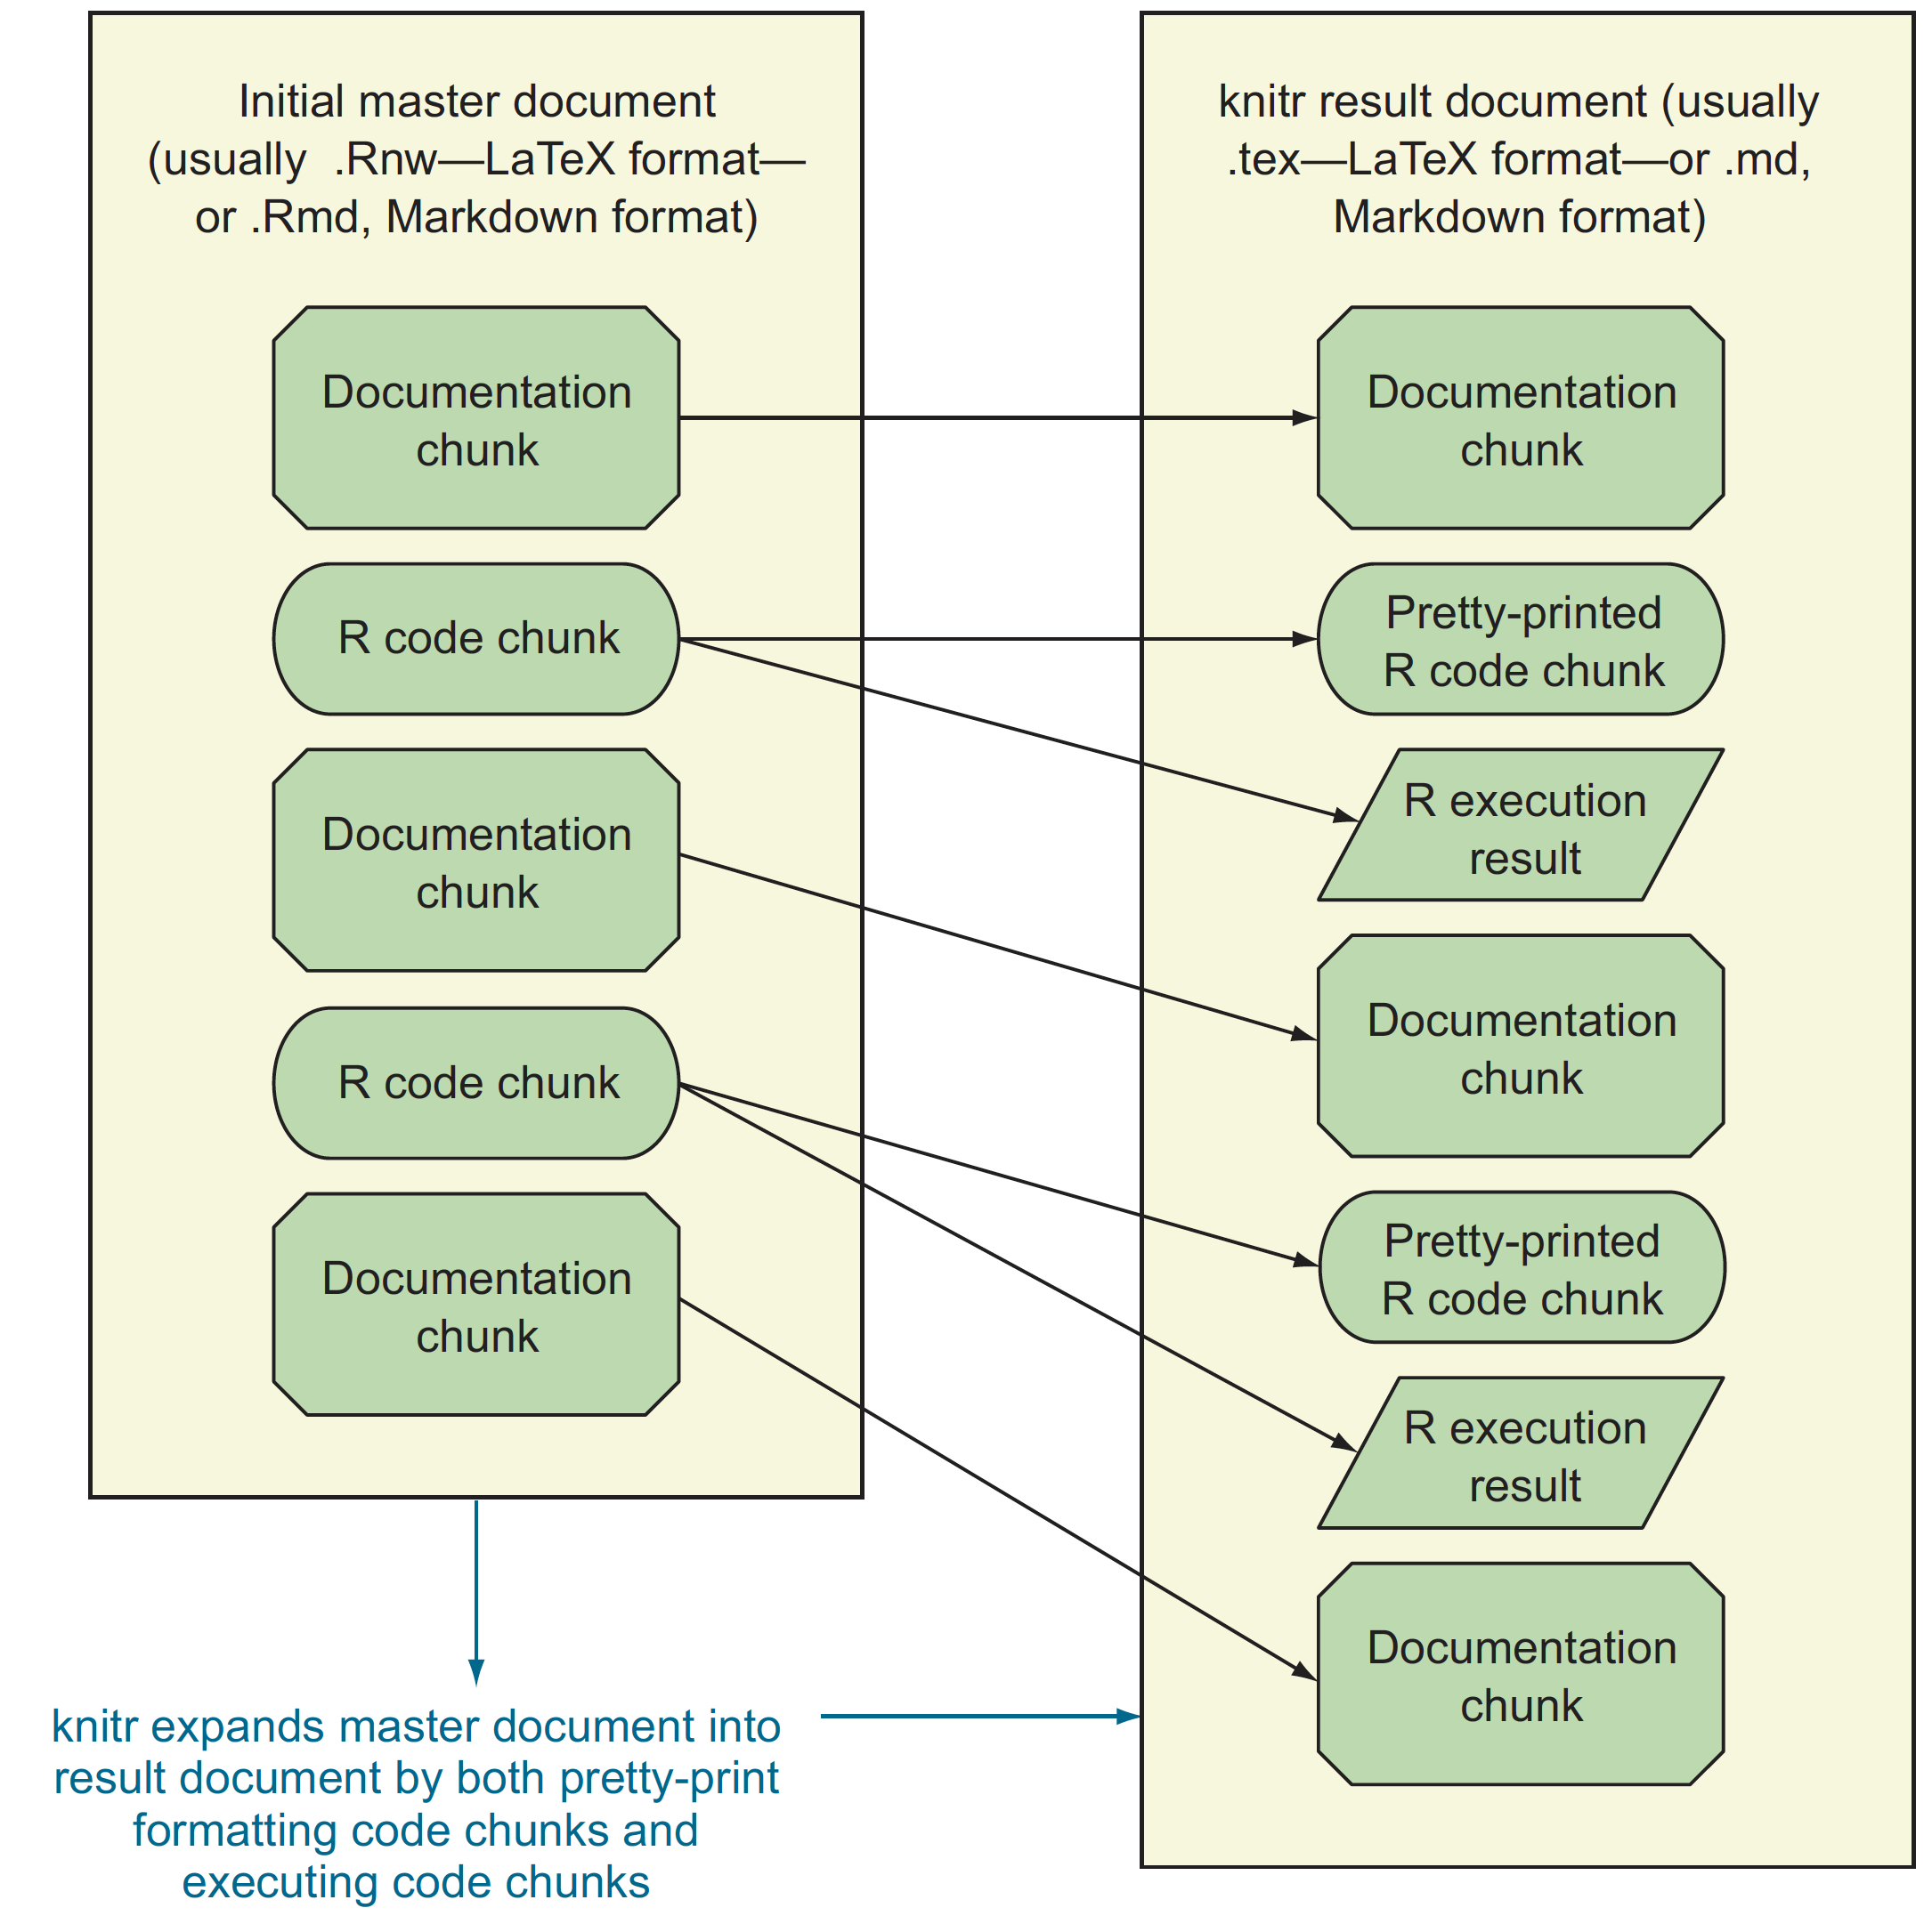
R Markdown format, .Rmd
running documentation
the form of code comment
milestone/checkpoint documentation
Figure10.1,Practical Data Science with R by Nina Zumel, John Mount

Slide 125

What is rmarkdown?
https://vimeo.com/178485416
.Rmd files
Develop your code and ideas side-by-side in a single document. Run code as individual chunks or as an entire document.
Dynamic Documents
Knit together plots, tables, and results with narrative text. Render to a variety of formats like HTML, PDF, MS Word, or MS Powerpoint.
Reproducible Research
Upload, link to, or attach your report to share. Anyone can read or run your code to reproduce your work.
Credit by CC BY SA Posit Software, PBC, Updated: 2023-07

Slide 126
R Markdown files are designed to be used in three ways
For communicating to decision makers, who want to focus on the conclusions, not the code behind the analysis.
For collaborating with other data scientists (including future you!), who are interested in both your conclusions, and how you reached them (i.e. the code).
As an environment in which to do data science, as a modern day lab notebook where you can capture not only what you did, but also what you were thinking.
R for Data Science by Garrett Grolemund, Hadley Wickham

Slide 127
Using knitr to produce milestone documentation
library(knitr)
knit('simple.Rmd')
Figure10.2, Practical Data Science with R by Nina Zumel, John Mount
Notes:
搭配 R Markdown cheat sheet

Slide 128
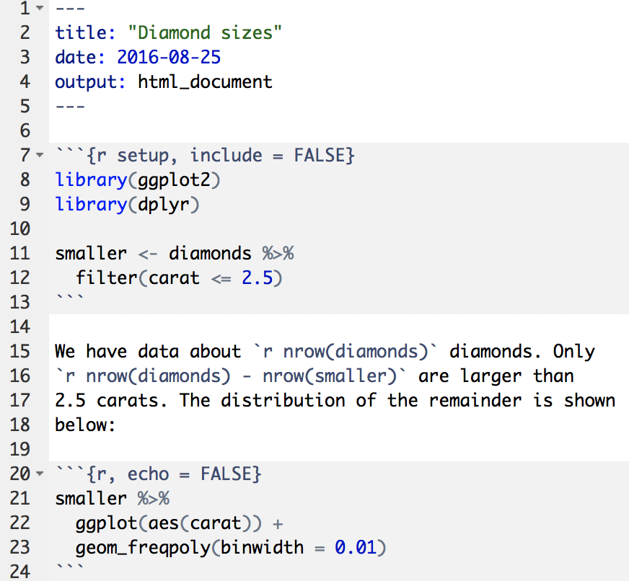
diamond-sizes.Rmd
An (optional) YAML header surrounded by ---s. (yet another markup language)
Chunks of R code surrounded by ```.
Text mixed with simple text formatting like # heading and _italics_.
Practical Data Science with R by Nina Zumel, John Mount

Slide 129
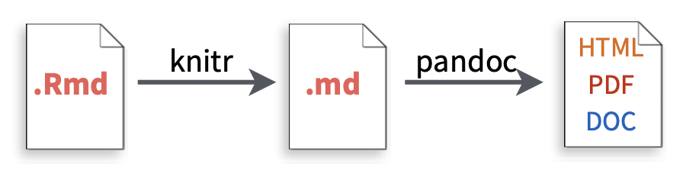
knit the document R Markdown
When you render, R Markdown
runs the R code, embeds results and text into .md file with knitr
then converts the .md file into the finished format with pandoc
Credit by CC BY SA Posit Software, PBC, Updated: 2023-07

Slide 130
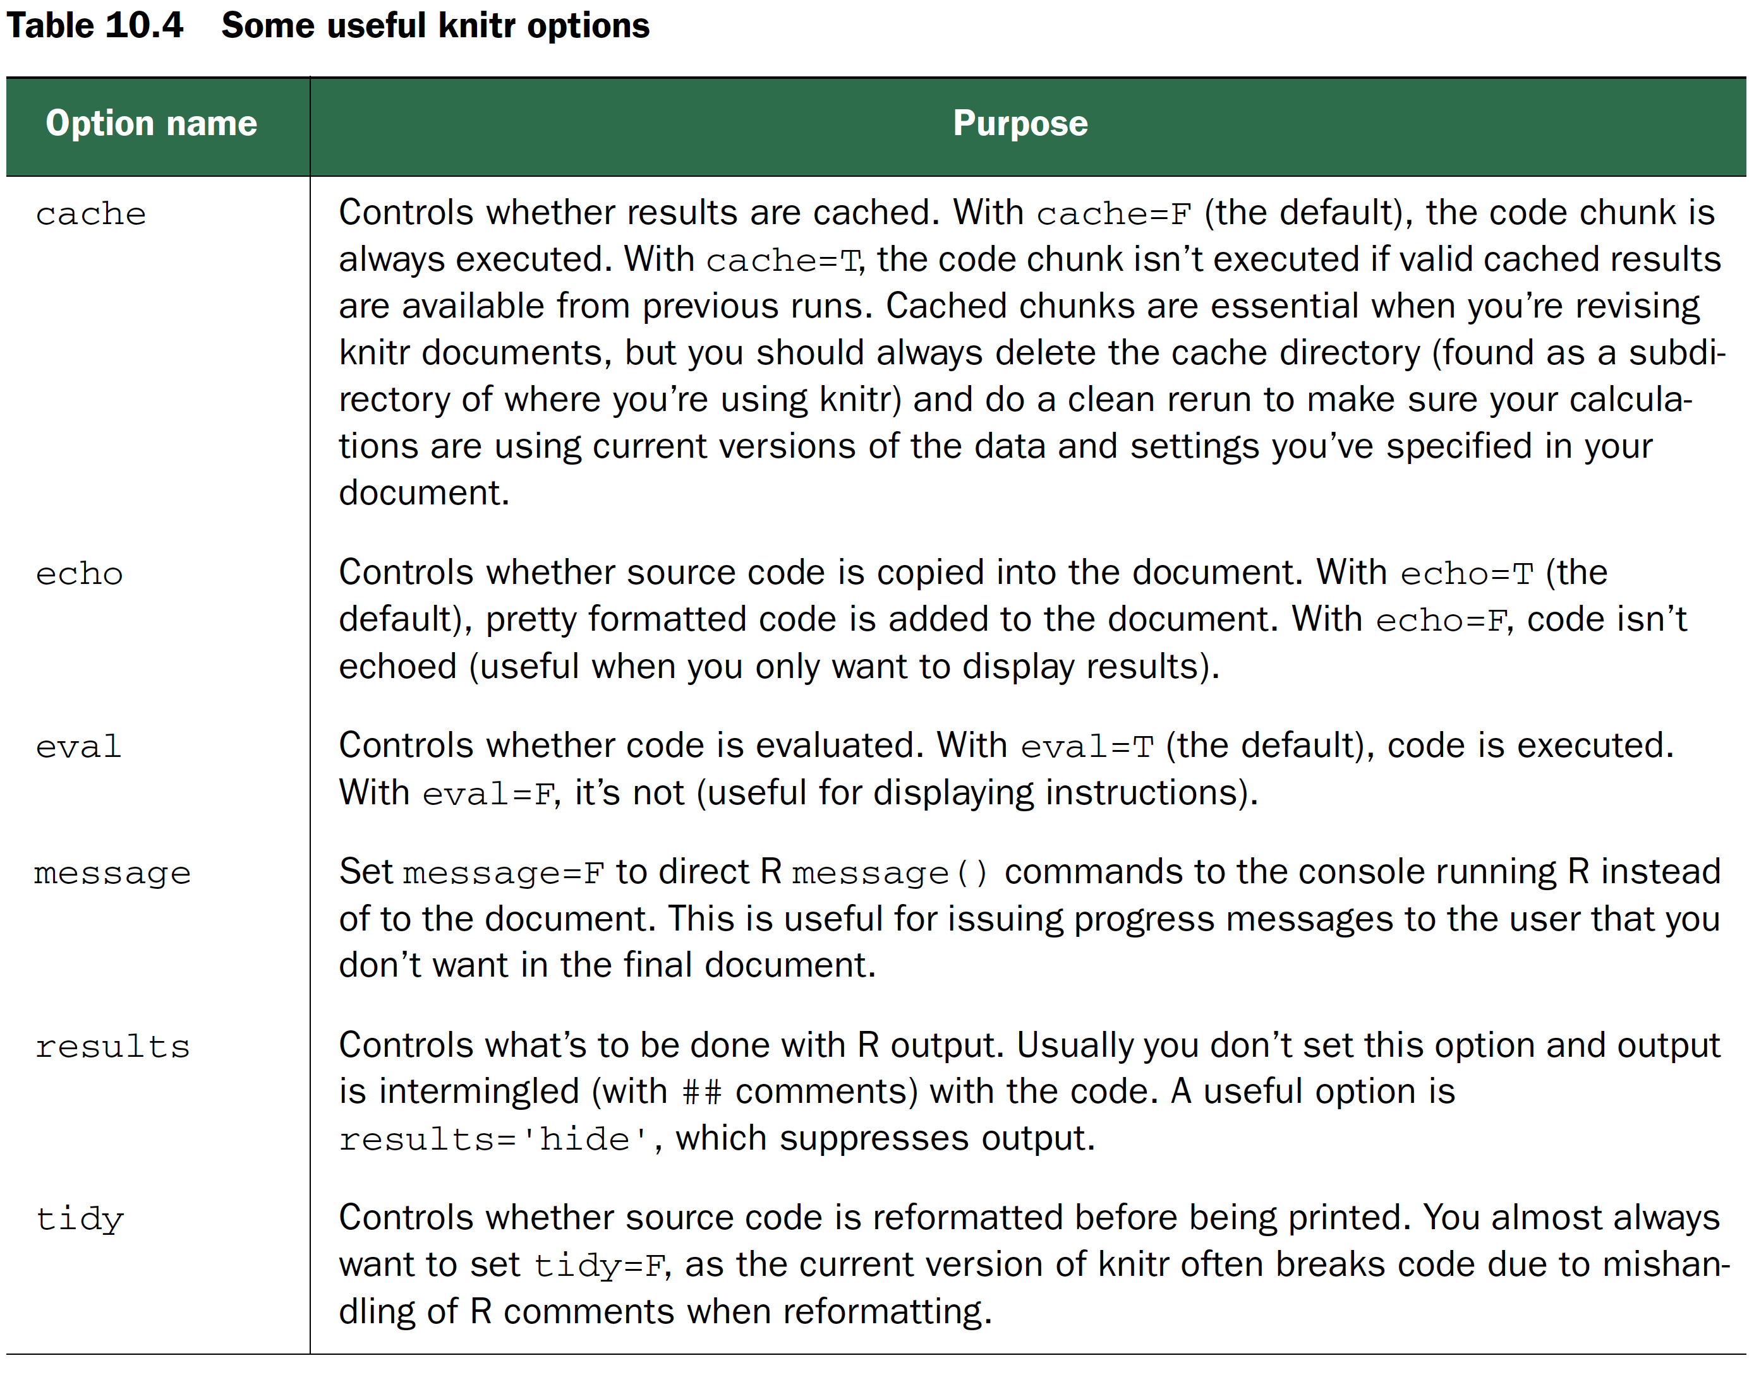
Knitr chunk options
Practical Data Science with R by Nina Zumel, John Mount

Slide 131
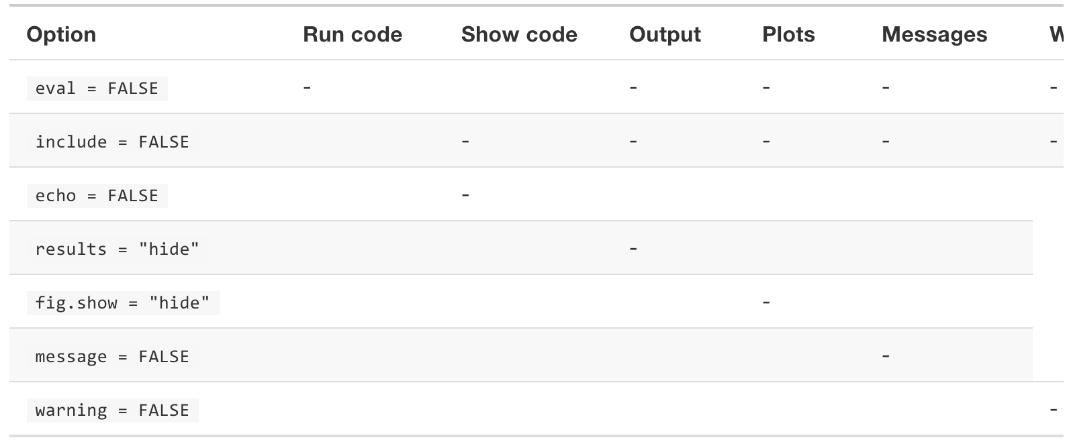
Output each option suppresses
R for Data Science by Garrett Grolemund, Hadley Wickham

Slide 132
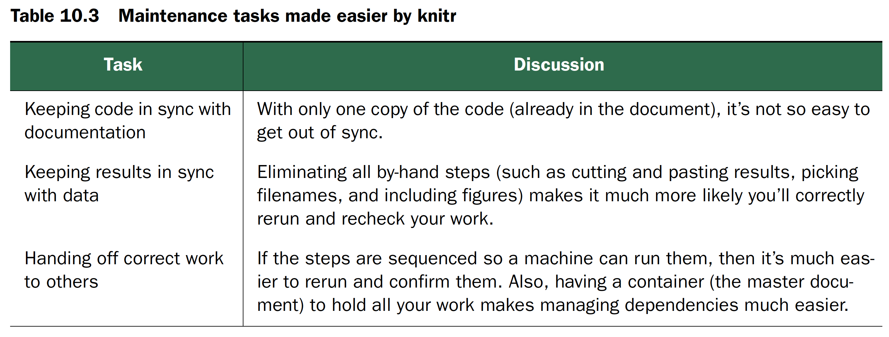
Purpose of Knitr
reproducible research
Practical Data Science with R by Nina Zumel, John Mount

Slide 133
Wrap Up

Slide 134
References
Books
Advanced R by Hadley Wickham
Names and values https://adv-r.hadley.nz/names-values.html
Object Oriented https://adv-r.hadley.nz/oo.html
Efficient R programming by Colin Gillespie & Robin Lovelace
https://bookdown.org/csgillespie/efficientR/
3.1 Top 5 tips for efficient programming
3.2 General advice
R Markdown
R Markdown from Rstudio
https://rmarkdown.rstudio.com/lesson-1.html
R Markdown Cheat Sheet
https://www.rstudio.com/wp-content/uploads/2016/03/rmarkdown-cheatsheet-2.0.pdf
R Markdown Reference Guide
https://www.rstudio.com/wp-content/uploads/2015/03/rmarkdown-reference.pdf

Slide 135
How to vectorize?
x = runif(n) + 1 log_sum = 0
for(i in 1:length(x))
log_sum = log_sum + log(x[i])
Credit by Colin Gillespie & Robin Lovelace, Efficient R programming

Slide 136


Thank You Any Question?

